Slide 1

Chakrai
An AI Therapeutic Ecosystem for Predictive Mental Health

Slide 2
Problem & Opportunity
• Mental health access is fragmented; demand outpaces human clinician supply.
• Consumers want immediate, personalized support that respects privacy.
• Providers need scalable tools for assessment, monitoring, and outcomes.
Chakrai: AI-native, clinically-informed platform delivering continuous support,
predictive insights, and therapist augmentation at consumer scale.
1 in 5 US adults face mental illness annually, but only 48% receive care

Slide 3
Product Overview
• Conversational AI therapy with memory continuity
• Journaling, mood tracking, analytics, crisis detection
• Voice-first interface (Whisper + ElevenLabs)
• Therapist portal, clinical exports, EHR-ready
• PWA architecture with privacy-first, HIPAA-aligned design

Slide 4
Why We Win — Key Differentiators
• 190-point clinical personality analysis for deep personalization
• Biometric Fusion & predictive modeling for proactive intervention
• Therapist B2B2C portal for distribution + outcomes
• Bulletproof device fingerprinting & data isolation
• Tiered pricing with clear upgrade paths (Free, Premium, Professional)

Slide 5
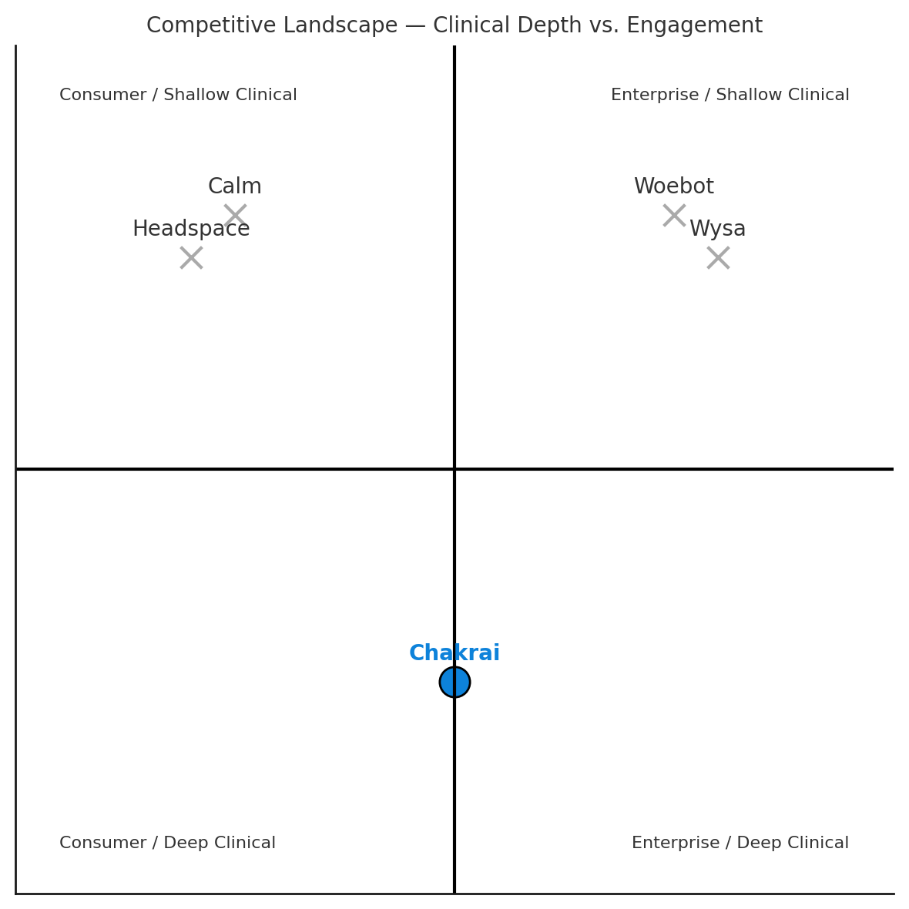

Slide 6
Market Opportunity (TAM/SAM/SOM)
Grand View Research projects the global mental health app market at $17.5B by 2030
• TAM: ~$10B global digital mental health market; strong double-digit CAGR.
• SAM: ~$3B US market across wellness apps, digital therapy, and telehealth.
• SOM (3-year target): $100M ARR via blended B2C + B2B2C approach.

Slide 7
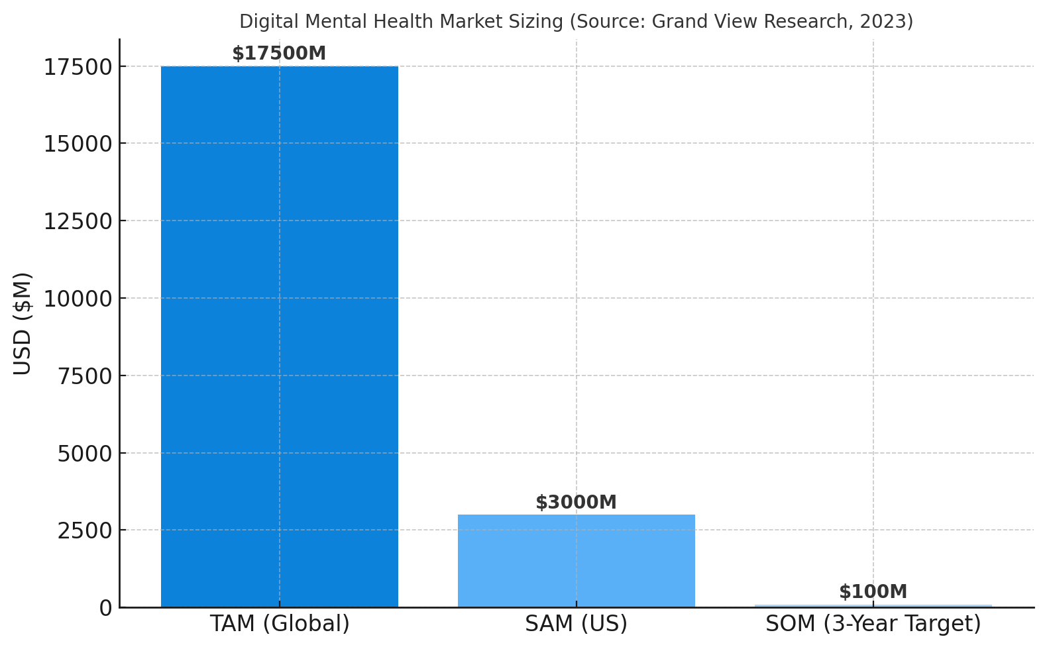

Slide 8
Business Model — Tiered Subscriptions
• Free — Basic wellness + mood tracking
• Premium ($9.99/mo) — 190+ dimensional analysis, unlimited insights, progress tracking
• Professional ($29.99/mo) — Therapist tools, clinical exports, API & integrations
• Enterprise — White-label, SSO, integrations

Slide 9
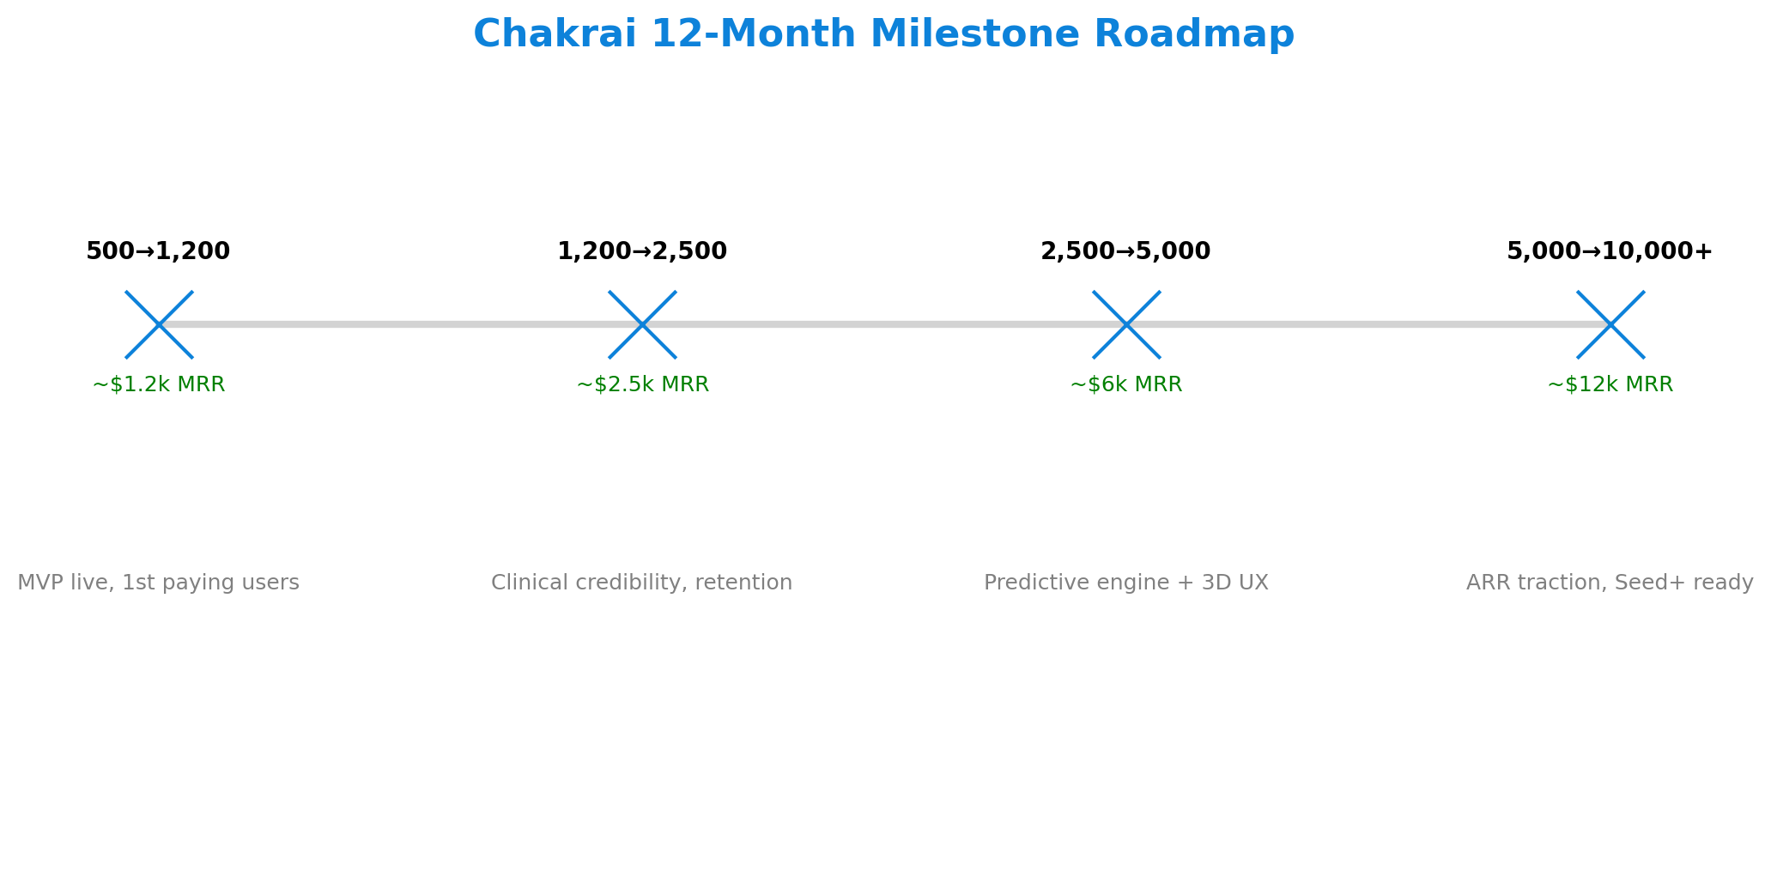
12-Month Product & Growth Roadmap

Slide 10
Financial Strategy (Year 1)
• Cumulative revenue ≈ $50k; MRR grows to ≈ $12k by Month 12
• Planned burn ≈ $41.6k/month; 12-month runway on $500k raise
• Next raise targeted Month 6–9 once traction is clear

Slide 11
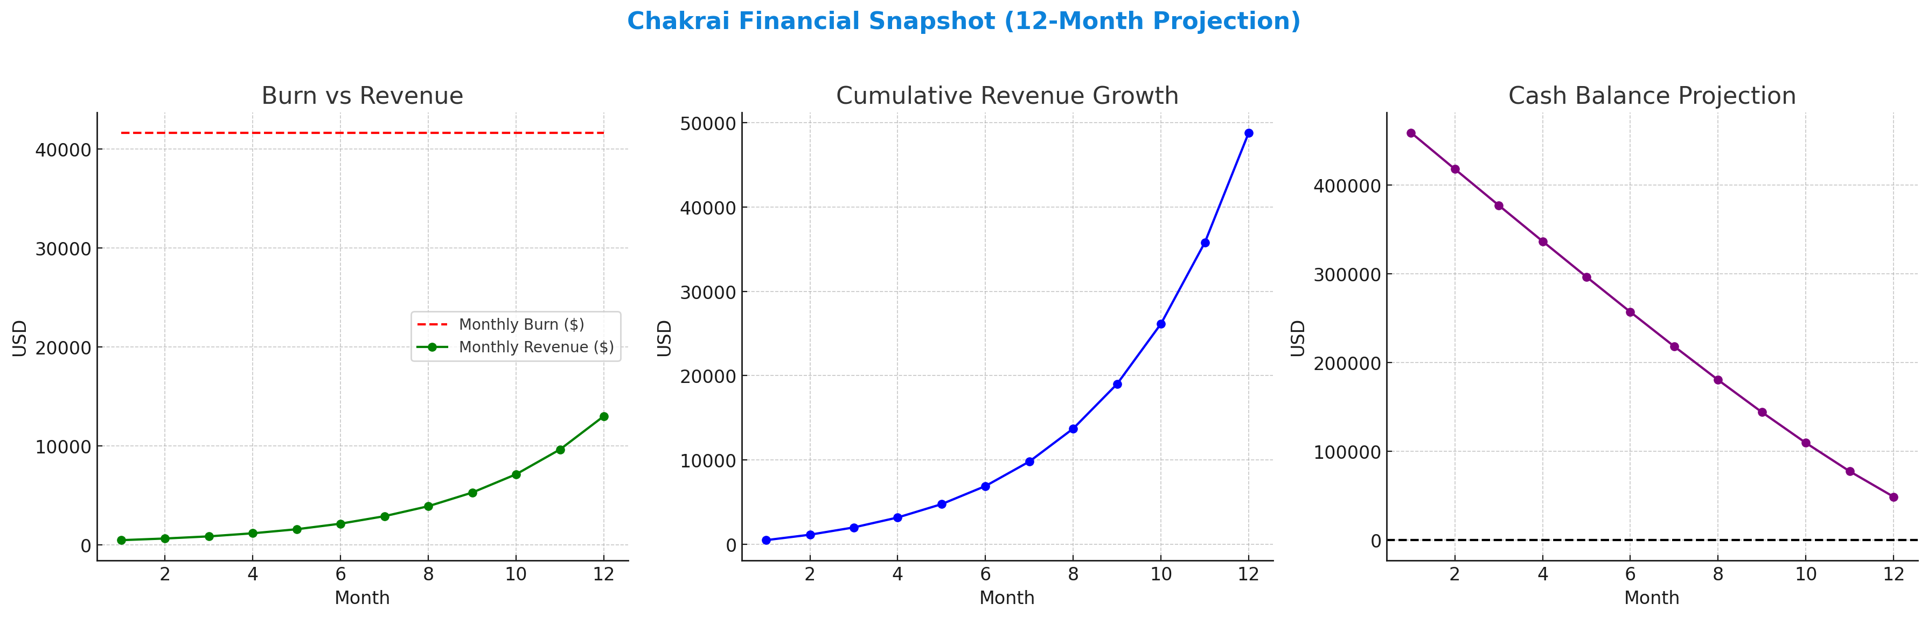
Financial Snapshot — Burn, Revenue, Runway
$500k gets us 12 months runway, $50k+ ARR traction, and a clear Seed+ milestone.

Slide 12
Use of Funds ($500k Seed)
• Product & Engineering — $225k (45%)
• Compliance & Security — $50k (10%)
• Cloud & Tools — $60k (12%)
• Marketing & Growth — $100k (20%)
• Ops & Admin — $40k (8%)
• Contingency — $25k (5%)

Slide 13
Go-to-Market
• B2C: App stores, influencer partnerships, community-led wellness challenges
• B2B2C: Therapist networks, employer wellness programs
• Clinical validation pilots with therapists/academic partners

Slide 14
Competitive Landscape
• Calm / Headspace — mindfulness content; limited clinical or predictive depth
• Wysa / Woebot — AI chat focus; enterprise-heavy
Chakrai: 190-point clinical analysis + biometric prediction + therapist portal + HIPAA-grade security

Slide 15
Security & Compliance
• Bulletproof device fingerprinting & user isolation
• HIPAA/GDPR-aligned architecture, auditability, encryption
• Zero data contamination by design

Slide 16
Team
• Daniel Sharpe — CEO (product, strategy, Tech, Engineering, fundraising)
• Advisors: Chakrai is being built with cutting-edge AI copilots across engineering, design, and operations.
AI Engineering Partner: Accelerates full-stack development and infrastructure.
AI Design Studio: Branding, UX, and rapid prototyping at scale.
AI Ops Assistant: Automates research, market modeling, and financial analysis.
Together, this lean + AI-augmented model allows Chakrai to build faster, cheaper, and smarter than traditional startups.

Slide 17
The Ask & Terms
• Raise: $500k seed (minimum close $250k)
• Use: Ship Chakrai 2.0, biometric prediction, therapist pilots, early ARR
• Target valuation range: $5–8M post-money for 6–10% equity
• Minimum check: $25k

Slide 18
Deal Structure Options
Term | Equity | SAFE / Convertible Note
Raise Amount | $250k–$500k | $250k–$500k
Valuation / Cap | $5M–$8M post-money | $6M–$8M cap
Equity / Discount | 5–10% equity | 20% discount
Runway / Maturity | 12 months runway | 18–24 months maturity

Slide 19
Contact
Daniel Sharpe — daniel@yobot.bot 602-785-0165
Scottsdale, AZ 85262

